Slide 1

Wireless Networks
ICT-4107
By-
Dr. Jesmin Akhter
Professor
Institute of Information Technology
Jahangirnagar University

Slide 2
Contents
The course will mainly cover the following topics:
Wireless Networking
Multiple Access techniques
FDMA, TDMA and CDMA systems
Modulation Techniques
Analog and digital modulation techniques, Performance of various modulation techniques - Spectral efficiency, Error rate
The Cellular Concepts and System Design Fundamentals
Cellular concept and frequency reuse, Channel assignment and handoff, Interface and system capacity, Trunking and Erlang capacity calculations
Mobile Radio Propagation
Radio wave propagation issues in personal wireless systems, Propagation models, Multipath fading, Parameters of mobile multipath channels, Antenna systems in mobile radio.
Cellular Wireless Networks
Principles of Cellular Networks
First-Generation Analog
Second-Generation TDMA
Second-Generation CDMA
Third-Generation Systems

Slide 3
Outline
Wireless Networking
Wireless LAN Technologies
Wireless Link Characteristics
Mobile Ad-Hoc Networks
Wireless Sensor Networks
Major Problems with Wireless network

Slide 4
Wireless LAN Technologies
Wireless LAN technologies can be classified into four types:
Infrared
Narrowband RF
Spread-spectrum
Home RF and Bluetooth.

Slide 5
Infrared LANs
Each signal-covering cell in an infrared LAN is limited to one room. Coverage is small, since the infrared rays cannot penetrate through wall and other opaque obstacles. The primary difference between infrared and radio wireless LANs is the frequency of the transmitted signal. 802.11a and 802.11b operate in the 2.4 and 5GHz bands respectively, but infrared systems use frequencies in the terahertz range.
The use of infrared has several advantages. For example, the bandwidth for infrared communication is large and can therefore achieve high data rates. Also, because infrared rays are reflected by lightly colored objects, it is possible to cover the entire area of the room with reflections from objects. Since infrared cannot penetrate through walls and other opaque obstacles, it becomes very difficult for any adversary to carry out a passive attack or to eavesdrop. Hence, communication with infrared technology is more secure. Also, separate infrared networks can be used in adjacent rooms without any interference effects. Finally, equipment for infrared communication is much cheaper than microwave communication. The one major disadvantage of infrared technology is that background radiation from sunlight and indoor lighting can cause interference at the infrared receivers.
Notes:
Infrared at 1 Mbps and 2Mbps operates at wavelength between 850nm and 950nm.
Infrared signals are placed in the light region invisible to the human eye.
Omnidirectional antenna, an antenna that radiates equally in all directions. omnidirectional
Diffuse mean spread out, or the action of spreading out.

Slide 6
Infrared LANs
Three alternative transmission techniques are used for infrared data transmission:
Direct beam (point-to-point connection): Like a vehicle head light illuminates the road. The most familiar direct infrared communication device is the TV remote control. Another wireless input and control devices, such as wireless mice, wireless game controllers, and remote electronic keys. High gain directional antennas can transmit and receive wireless signals for several miles given clear line of sight and sufficient transmit power like building-to-building connections for high-speed network access or metropolitan- or campus-area networks.,
Omnidirectional configuration: Consists of a single BS that is normally used on ceilings providing 360⁰ donut shaped radiation pattern to provide the widest possible signal coverage in indoor and outdoor wireless applications,
Diffused configuration The transmitter directs the signal to a diffused reflecting ceiling. The signal is reflected in all directions from the ceiling in much the same way as a conventional light bulb illuminates a room . The infrared signal bounces off the walls and ceiling so that a receiver can pick up the signal regardless of orientation. These systems are well suited to the wireless LAN application, freeing the user from knowing and aligning with the locations of the other communicating devices.

Slide 7
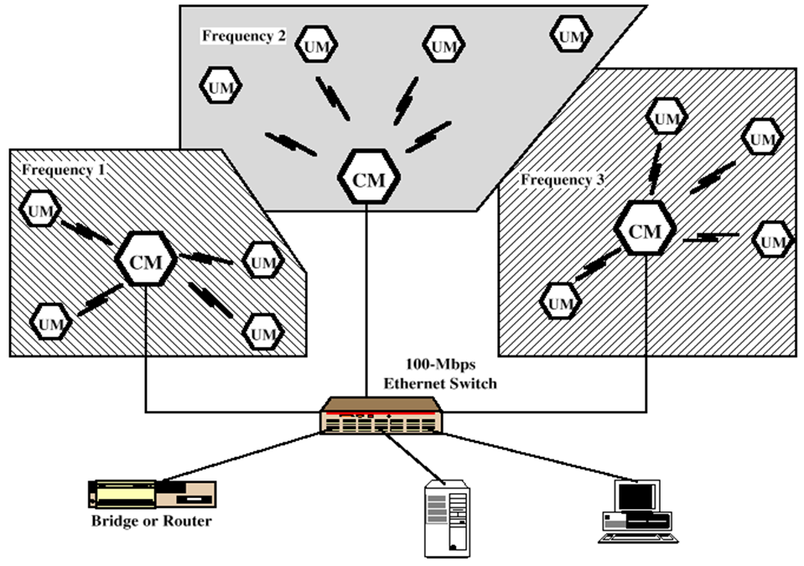
Narrowband RF LANs
Narrowband RF LANs use very narrow bandwidth.
Adjacent cells use different frequency bands.
The transmissions are encrypted to prevent attacks.
There are several Control Module (CM) to interface wireless LAN to the backbone Ethernet (wired LAN).
In the figure each cell has its own CM and connected by a switch to route traffic among them.
UM→ User Module
Notes:
Narrowband is usually considered to cover frequencies 300–3400 Hz.
Narrowband Microwave LANs: Licensed Narrowband RF Licensed narrowband LAN guarantees interference-free communication
UnLicensed Narrowband RF This spectrum can be used for narrowband transmission at low power (<0.5 W). The product operates at 10 Mbps in the 5.8 GHz band and has a range of 50 m in a semi-open office and 100 m in an open office.
Wired Equivalent Privacy (WEP) - a low-level data encryption system – was invented for wireless security purposes. WEP protocol protects link level data during wireless transmission between clients and access points. It does not provide end-to-end security, but only for the wireless portion of the connection

Slide 8
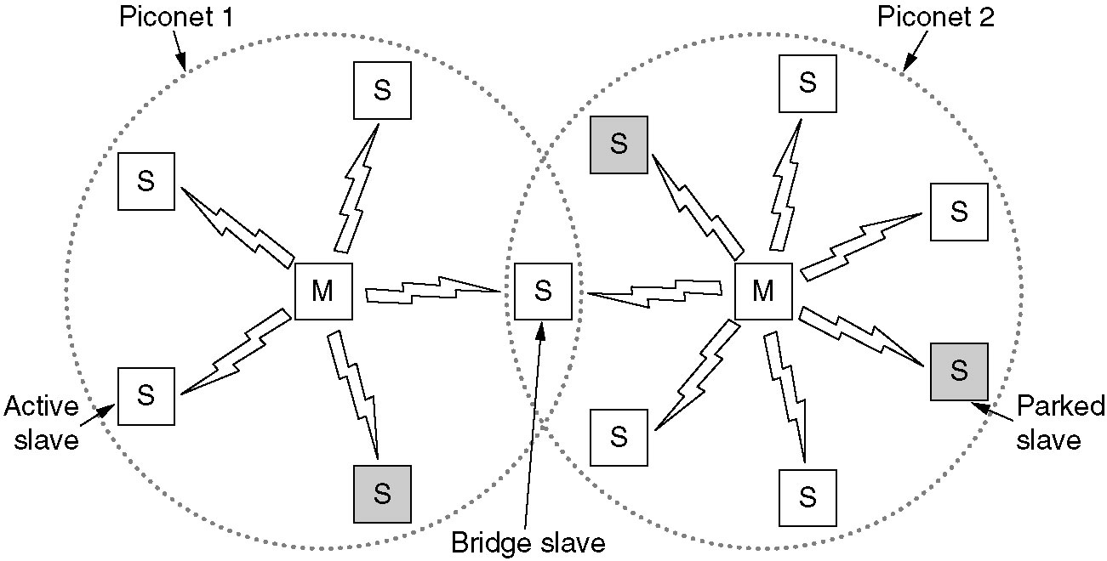
Home RF and Bluetooth
Home RF supports data rates of about 2Mbps and has range of about 50m.
Bluetooth is a wireless LAN technology designed to connect devices of different functions such as telephone, notebooks, computers, cameras, printers etc.
Bluetooth defines two types of networks called: piconet and scatternet.
A piconet can have up to eight stations, one of which is called primary station, the rest are called secondaries. All the secondary stations synchronize their clocks and hopping sequence with the primary. Bluetooth uses frequency-hopping spread spectrum (FHSS) in the physical layer to avoid interference from other devices or network.
Notes:
Piconets have a 7 member address space (3 bits, with zero reserved for broadcast), which limits the maximum size of a piconet to 8 devices, i.e. 1 master and 7 slaves.
A scatternet is a number of interconnected piconets that supports communication between more than 8 devices. Scatternets can be formed when a member of one piconet (either the master or one of the slaves) elects to participate as a slave in a second, separate piconet. The device participating in both piconets can relay data between members of both ad hoc networks. However, the basic Bluetooth protocol does not support this relaying - the host software of each device would need to manage it. Using this approach, it is possible to join together numerous piconets into a large scatternet, and to expand the physical size of the network beyond Bluetooth's limited range.
Currently there are very few actual implementations of scatternets due to limitations of Bluetooth and the MAC address protocol. However, there is a growing body of research being conducted with the goal of developing algorithms to efficiently form scatternets.
A number of companies have attempted to launch social networking and dating services that leverage early scatternet implementations (see Bluedating). Scatternets can also be used to enable ad hoc communication and interaction between autonomous robots and other devices.

Slide 9
Piconets can be combined to form scatternet where a secondary user of one piconet acts as bridge to another piconet. The bridge secondary/slave acts as a primary in receiving packets from the original primary of first piconet then deliver the packet to secondaries of the second piconet.
Although a piconet can have maximum 7 secondaries , additional secondaries can be in parked state. A seconadry in parked state is synchronized with the primary, but can not take part in communication until it is removed from parked state to the active state.
Notes:
Let's say you have a typical modern living room with typical modern stuff inside. There's an entertainment system with a stereo, a DVD player, a satellite TV receiver and a television; there's also a cordless telephone and a personal computer. Each of these systems uses Bluetooth, and each forms its own piconet to talk between the main unit and peripheral.

Slide 10
Two types of links can be created between primary and secondary:
A synchronous connection-oriented (SCO) link is used when avoiding latency (delay in data delivery) is more important than integrity (error free delivery) for example real time audio. If a packet is damaged it is never retransmitted.
An asynchronous connectionless link (ACL) is used when data integrity is more important than avoiding latency. In this type link if payload encapsulated in the frame is lost/ corrupted, it is retransmitted.

Slide 11
Layers of Bluetooth
Application Layer
L2CAL layer
Baseband layer
Radio Layer
Radio layer is like physical layer of Internet. Uses FHSS, GFSK modulation.
Baseband waveform is passed through a Gaussian filter to make the transitions smoother so to limit its spectral width.
Baseband layer is like MAC sublayer uses TDMA slot as the physical channel.
Time-division multiple access (TDMA) is a channel access method for shared-medium networks.
It allows several users to share the same frequency channel by dividing the signal into different time slots.
The users transmit in rapid succession, one after the other, each using its own time slot.
Logical Link Control and Adaption Protocol (L2CAP) is like LLC sublayer.
The LLC layer is concerned with managing traffic (flow and error control) over the physical medium
Applications Layer − This includes the application profiles that allow the user to interact with the Bluetooth applications.
Notes:
A GFSK modulator differs from a simple frequency-shift keying modulator in that before the baseband waveform (levels −1 and +1) goes into the FSK modulator, it is passed through a Gaussian filter to make the transitions smoother so to limit its spectral width.
Time-division multiple access (TDMA) is a channel access method for shared-medium networks. It allows several users to share the same frequency channel by dividing the signal into different time slots. The users transmit in rapid succession, one after the other, each using its own time slot.
The LCL layer is concerned with managing traffic (flow and error control) over the physical medium. The LCL layer also identifies a line protocol, such as SDLC, NetBIOS, or NetWare, and may also assign sequence numbers to frames and track acknowledgements. It accepts packets up to 64 kB from upper layer and breaks into frames for transmission.
LLC, that interacts with the Application layer above and the lower sub-layer, termed as MAC, that interacts with the physical layer below.
LLC, that interacts with the network layer above and the lower sub-layer, termed as MAC, that interacts with the physical layer below

Slide 12
Wireless Link Characteristics
important differences from wired link ….
decreased signal strength: radio signal attenuates as it propagates through matter (e.g., a radio signal passing through a wall). Even in free space, the signal will disperse, resulting in decreased signal strength (sometimes referred to as path loss) as the distance between sender and receiver increases.
interference from other sources: standardized wireless frequencies (e.g., 2.4 GHz) shared by other devices (e.g., phone); devices (motors, a microwave) interfere as well
multipath propagation: radio signal reflects off objects/ground, reaching destination at slightly different times as it takes paths of different lengths between a sender and receiver. This results in the blurring of the received signal at the receiver. Moving objects between the sender and receiver can cause multipath propagation to change over time.
Bit errors will be more common in wireless links than in wired links which make communication across (even a point to point) wireless link much more “difficult”
Notes:
In wireless telecommunications, multipath is the propagation phenomenon that results
in radio signals reaching the receiving antenna by two or more paths. Causes
of multipath include atmospheric ducting, ionospheric reflection and refraction, and
reflection from water bodies and terrestrial objects such as mountains and buildings.
The effects of multipath include constructive and destructive interference, and phase
shifting of the signal. In digital radio communications (such as GSM) multipath can
cause errors and affect the quality of communications.
Electrical interference: Appliances like air conditioners, heavy motors, x-ray machines and even sometimes hair driers and electric heaters can interfere with the WiFi signal. ... Weather / Environmental Interference: Lightening can disrupt RF signals totally, heavy rain and fog also dampen the signal distance and quality.

Slide 13
Wireless Link Characteristics
SNR: signal-to-noise ratio
This host receives an electromagnetic signal that is a combination of a degraded form of the original signal transmitted by the sender (degraded due to the attenuation and multipath propagation effects) and background noise in the environment. The signal-to-noise ratio (SNR) is a relative measure of the strength of the received signal (i.e., the information being transmitted) and this noise. The SNR is typically measured in units of decibels (dB).
larger SNR – easier to extract signal from noise (a “good thing”)

Slide 14
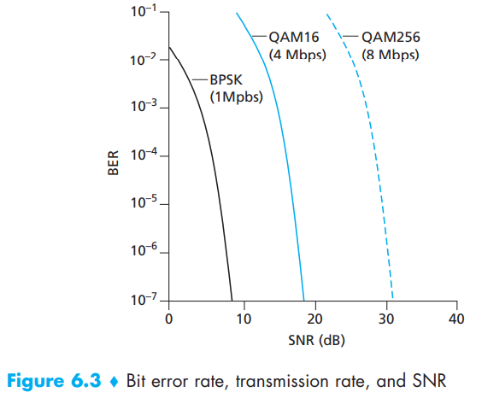
Wireless Link Characteristics: Physical-layer characteristics
Figure shows the bit error rate (BER)—The probability that a transmitted bit is received in error at the receiver—versus the SNR for three different modulation techniques for encoding information for transmission on an idealized wireless channel.

Slide 15
Wireless Link Characteristics: Physical-layer characteristics
For a given modulation scheme, the higher the SNR, the lower the BER. Since a sender can increase the SNR by increasing its transmission power, a sender can decrease the probability that a frame is received in error by increasing its transmission power
There are also disadvantages associated with increasing the transmission power:
More energy must be used by the sender (an important concern for battery-powered mobile users), and the sender’s transmissions are more likely to interfere with the transmissions of another sender.
Notes:
. Note, however, that there is arguably little practical gain in increasing the power beyond a certain threshold,

Slide 16
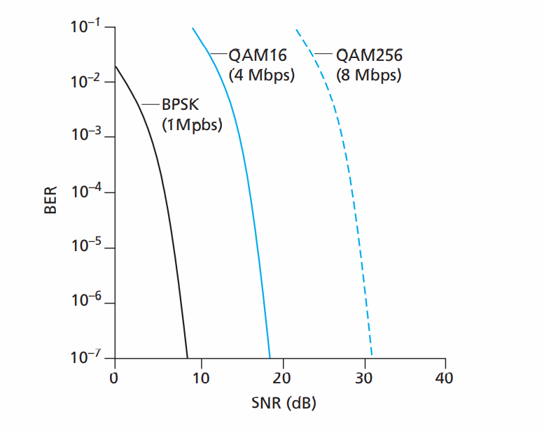

Slide 17
Wireless Link Characteristics: Physical-layer characteristics
For a given SNR, a modulation technique with a higher bit transmission rate (whether in error or not) will have a higher BER. For example, in with an SNR of 10 dB, BPSK modulation with a transmission rate of 1 Mbps has a BER of less than 10⁻⁷, while with QAM16 modulation with a transmission rate of 4 Mbps, the BER is 10⁻¹, far too high. However, with an SNR of 20 dB, QAM16 modulation has a transmission rate of 4 Mbps and a BER of 10⁻⁷, while BPSK modulation has a transmission rate of only 1 Mbps and a BER that is so low as to be (literally) “off the charts.”
Dynamic selection of the physical-layer modulation technique can be used to adapt the modulation technique to channel conditions. The SNR (and hence the BER) may change as a result of mobility or due to changes in the environment. Adaptive modulation and coding are used in cellular data systems and in the 802.11 WiFi and 3G cellular data networks. This allows, for example, the selection of a modulation technique that provides the highest transmission rate possible subject to a constraint on the BER, for given channel characteristics.

Slide 18


Wireless Link Characteristics: Physical-layer characteristics
A higher and time-varying bit error rate is not the only difference between a wired and wireless link. Recall that in the case of wired broadcast links, all nodes receive the transmissions from all other nodes. In the case of wireless links, the situation is not as simple. Multiple wireless senders and receivers create additional problems:
A
B
C
C
A’s signal
strength
C’s signal
strength
B
A
Hidden terminal problem
B, A hear each other
B, C hear each other
A, C can not hear each other means A, C unaware of their interference at B
space
Signal attenuation:
B, A hear each other
B, C hear each other
A, C can not hear each other interfering at B

Slide 19
Overview of Wireless Ad-Hoc Networks
Wireless mobile ad-hoc network (MANET) technology is designed for the establishment of a network anywhere and anytime, without any fixed infrastructure to support the mobility of the users in the network.
In other words, a wireless ad-hoc network is a collection of mobile nodes with a dynamic network infrastructure forming a temporary network. Such networks no central server or base station for providing connectivity, and all network intelligence must be placed inside the mobile user devices.

Slide 20
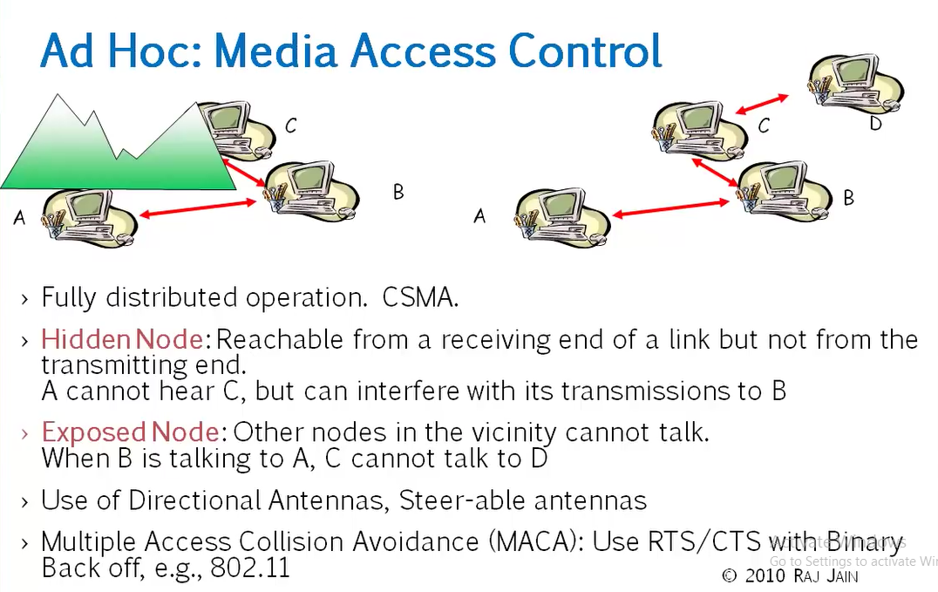

Slide 21
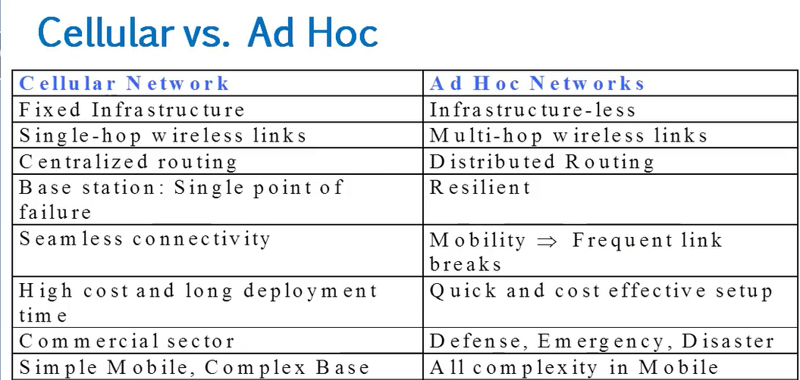

Slide 22
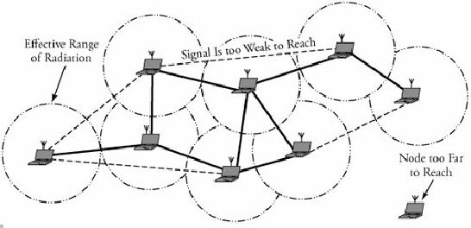
Fig.1gives overview of an ad-hoc network, where wireless mobile nodes have formed a network, with one node too far to reach.
Fig.1 Overview of Ad-Hoc Networks

Slide 23
In such an environment, each mobile user acts as a routing node, and a packet is routed from a source to its destination by incorporating of other network users.
Since the topology of an ad-hoc network can change quickly and unpredictably, it should be adaptable to changes, such as when a link breaks, a node leaves the network, or a new node is attached to the network.
Thus, unlike intra domain routing algorithm for regular networks, if a node leaves an ad-hoc network, all affected nodes can discover new routes.

Slide 24
Applications
Ad-hoc networks have several types of applications
Rescue operations. In an emergency public disaster, such as an earthquake, ad-hoc networks can be set up at a location where no infrastructure is present. Ad-hoc networks can be used to support network connectivity when no fixed network is available.
Military. Ad-hoc networks can be used in a battle zone, for a military command and mobile units.
Law enforcement and security operations. An ad-hoc network can be used in a temporary security operation, acting as a mobile surveillance network.
Home networks. An ad-hoc network can be used to support seamless (continuous) connectivity among various devices.
Conferencing. Ad-hoc networks can be set up for a presentation. An audience can download a presentation, browse the slides on a portable device, print them on the local printer, or e-mail the presentation to an absent colleague.

Slide 25
Routing in Ad-Hoc Networks
The lack of a backbone infrastructure makes packet routing in ad-hoc networks a challenging task. A routing protocol should be able to automatically recover from any problem in a finite amount of time without human intervention.
Identification of mobile terminals and correct routing of packets to and from each terminal while moving are certainly challenging. Here we will consider two routing protocols:
1. Destination-Sequenced Distance Vector (DSDV) Protocol
2. Cluster-Head Gateway Switch Routing Protocol

Slide 26
The Destination-Sequenced Distance Vector (DSDV) protocol is a table-driven routing protocol
Routing Tables
In addition to the destination address and next hop address, routing tables maintain the route metric (for example number of hops) and the route sequence number.
Periodically, or immediately when network topology changes are detected, each node will broadcast a routing table update packet. The update packet starts out with a metric of one. This signifies to each receiving neighbor they are one hop away from the node. The neighbors will increment this metric (in this case, to two) and then retransmit the update packet.
This process repeats itself until every node in the network has received a copy of the update packet with a corresponding metric. If a node receives duplicate update packets, the node will only pay attention to the update packet with the smallest metric and ignore the rest.

Slide 27
DSDV Packet Process Algorithm
To distinguish state update packets from valid ones, each update packet is tagged by the original node with a sequence number. The sequence number is a monotonically increasing number which uniquely identifies each update packet from a given node.
Consequently, if a node receives an update packet from another node, the sequence number must be equal to or greater than the sequence number already in the routing table
If the new address has a higher sequence number, the node chooses the route with the higher sequence number and discards the old sequence number.
If the incoming sequence number is identical to the one belonging to the existing route, a route with the least cost metric is chosen.

Slide 28
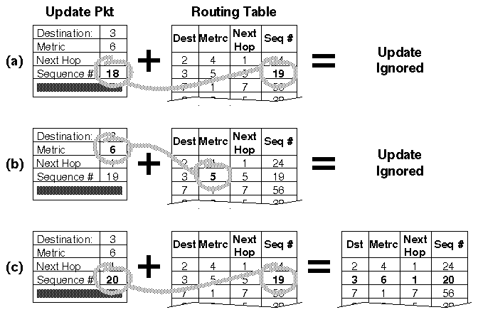
Fig.5 : A node receiving three update packets

Slide 29
The packet overhead of the DSDV protocol increases as the total number of nodes increases in the ad-hoc network. This fact makes DSDV suitable for small networks. In large ad-hoc networks, the mobility rate and therefore the overhead increase, making the network unstable to the point that updated packets might not reach nodes on time.

Slide 30
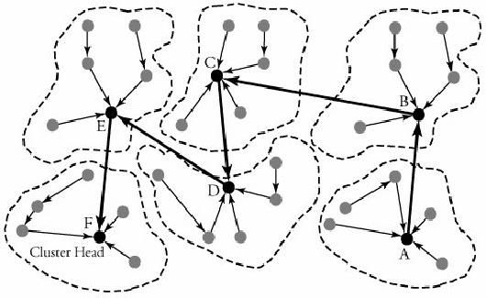
2. Cluster-Head Gateway Switch Routing Protocol
The Cluster-Head Gateway Switch Routing (CGSR) protocol is a table-driven routing protocol. In a clustering system each predefined number of nodes are formed into a cluster controlled by a cluster head, which is assigned using a distributed clustering algorithm.

Slide 31
However, with the clustering scheme, a cluster head can be replaced frequently by another node, for several reasons, such as lower-level energy left in the node or a node moves out of contact.
With this protocol, each node maintains two tables: a cluster-member table and a routing table. The cluster-member table records the cluster head for each destination node, and the routing table contains the next hop to reach the destination.

Slide 32
Fig.7 shows an example of routing in an area in which six clusters have been formed. A node in cluster A is transmitting a packet to a node in cluster F.
Nodes within each cluster route their packets to their own associated clusters. The transmitting node then sends its packet to the next hop, according to the routing table entry associated with that cluster head. The cluster head transmits the packet to another cluster head until the cluster head of the destination node is reached.
Fig.3 Communication with cluster head gateway switch routing (CGSR) protocol

Slide 33
Wireless Sensor Networks

Slide 34
Definition
A sensor network is an infrastructure comprised of sensing (measuring), computing, and communication elements. The results acquired by a regional network is provided to the administrator.
The administrator observe and react to events/phenomena in a specified environment. The administrator typically is a civil, governmental, commercial, or industrial entity.
The environment can be the physical world (temperature, pressure, sound), a biological system (biological and chemical sensors for national security applications for example Air pollution monitoring, Water quality monitoring) or an information technology (IT) framework.

Slide 35
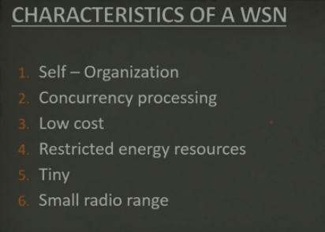

Slide 36
Applications
A wide-range of applications offered by WSN, some of these are environmental monitoring, industrial sensing, infrastructure protection, battlefield awareness and temperature sensing.
A short list of applications follows.
Military applications
Monitoring inimical forces
Monitoring friendly forces and equipment
Military-theater or battlefield surveillance
Targeting
Battle damage assessment
Nuclear, biological, and chemical attack detection
and more . . .

Slide 37
Environmental applications
Microclimates
Forest fire detection
Flood detection
Precision agriculture
and more . . .
Health applications
Remote monitoring of physiological data
Tracking and monitoring doctors and patients inside a hospital
Drug administration
Elderly assistance
and more . . .

Slide 38
Home applications
Home automation
Instrumented environment
Automated meter reading
and more . . .
Commercial applications
Environmental control in industrial and office buildings
Inventory control
Vehicle tracking and detection
Traffic flow surveillance
and more . . .

Slide 39
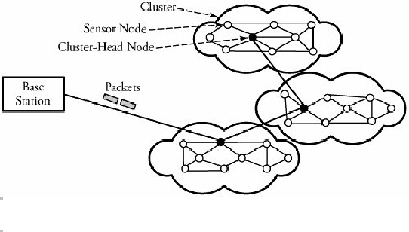
Infrastructure of Sensor Networks
The region being sensed is normally partitioned into equally loaded clusters of sensor nodes, as shown in Figure 2. A cluster in a sensor network resembles a domain in a computer network. In other words, nodes are inserted in the vicinity of a certain predefined region, forming a cluster. Different types of sensors can also be deployed in a region.
In Figure 2, three clusters are interconnected to the main base station, each cluster contains a cluster head responsible for routing data from its corresponding cluster to a base station.
Figure 2. A sensor network and its clusters

Slide 40
The wireless sensor node is equipped with a limited power source, such as a battery or even a solar cell, where there is enough sun light exposure on the node. However, a solar cell may not be the best choice as a power supply, owing to its weight, volume, and expense. In some application scenarios, sensor-node lifetime depends on the battery lifetime.

Slide 41
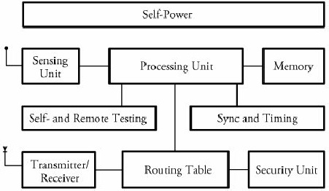
Sensor Node Structure
Figure 3 shows a typical sensor node. A node consists mainly of 3 components: sensing unit, a processing unit and memory, a self-power unit.
Other supporting components are: wireless transceiver component, as well as a self- and remote-testing unit, a synchronizing and timing unit, a routing table, and security units.
Each node must determine its location. This task is carried out by a location-finding system based on the global positioning system (GPS).
Fig.3 A typical wireless sensor node

Slide 42
Sensing Unit
The sensing unit consists of a sensor and an analog-to-digital converter. A smart sensor node consists of a combination of multiple sensors.
The analog signals produced by the sensors, based on the observed event, are converted to digital signals by the converter and then fed into the processing unit.

Slide 43
Processing and Memory Unit
The processing unit performs certain computations on the data and, depending on how it is programmed, may send the resulting information out to the network.
The processing unit, which is generally associated with memory, manages the procedures that make the sensor node collaborate with the other nodes to carry out the assigned sensing task.
The central processor determines what data needs to be analyzed, stored, or compared with the data stored in memory.

Slide 44
Self-Power Unit
A sensor node is supposed to be mounted in a small physical unit, limiting space for the battery. Moreover, the random distribution of sensors makes it impossible to periodically recharge or exchange batteries.
In most types of sensor networks, the power unit in a sensor node is the most important unit of the node because the liveliness and existence of a node depend on the energy left in the node, and the routing in the sensor network is based on the algorithm that finds a path with the least energy.
Thus, it is essential to use energy-efficient algorithms to prolong the life of sensor networks. The main task of the sensor node is to identify events, to process data, and then to transmit the data. The power of a node is consumed mainly in the transmitter and receiver unit.
The sensor node can be supplied by a self-power unit, self-power unit battery, or solar cells

Slide 45
Clustering Protocols
Clustering Protocols specify the topology of the hierarchical non-overlapping cluster nodes.
An efficient Clustering Protocol ensures the creation of clusters with almost the same radius and cluster heads that are the best positioned in the cluster.
Since every node in a cluster network is connected to cluster head, route discovery among cluster heads is sufficient to establish a feasible route in the network.

Slide 46
Classification of Clustering Protocols
Clustering techniques can be either centralized or decentralized.
Centralized clustering algorithms require each sensor node to send its individual information, such as energy level and geographical position, to the central base station. Based on a predefined algorithm, a base station calculates the number of clusters, their sizes, and the cluster heads' positions and then provides each node with its newly assigned duty.

Slide 47
Decentralized clustering techniques create clusters without the help of any centralized base station. An energy-efficient and hierarchical clustering algorithm can be such a way whereby each sensor node becomes a cluster head with a probability of p and advertises its candidacy to nodes that are no more than k hops away from the cluster head.
The Low-Energy Adaptive Clustering Hierarchy (LEACH) algorithm and the Decentralized Energy-Efficient Cluster Propagation (DEEP) protocol are two examples of the decentralized clustering protocols.

Slide 48
LEACH Clustering Protocol
The Low-Energy Adaptive Clustering Hierarchy (LEACH) is an application-specific protocol architecture that aims to prolong network lifetime by periodic re-clustering and change of the network topology.
LEACH is divided into rounds consisting of a clustering phase and a steady-state phase for data collection. At the start of each round, a sensor node randomly chooses a number between 0 and 1 and then compares this number to a calculated threshold called T(n). If T(n) is larger than the chosen number, the node becomes a cluster head for the current round. The value T(n) is calculated using the following formula:

Slide 49
r=0:15;
p=1/16;
Tn =p./(1-p*(mod(r,1/p)));
plot(r,Tn, 'b>-')
xlabel('r')
ylabel('T(n)')
grid on
r = 0 1 2 3 4 5 6 7 8 9 10 11 12 13 14 15
T_{n} = 0.0625 0.0667 0.0714 0.0769 0.0833 0.0909 0.1 0.1111 0.125 0.1429 0.1667 0.2 0.25 0.3333 0.5 1

Slide 50
where p is the ratio of the total number of cluster heads to the total number of nodes, r is the number of rounds, and G is a set of nodes that have not been chosen as cluster heads for the last 1/p rounds.
For the first round (r = 0), T(n) is equal to p, and nodes have an equal chance to become cluster head. As r gets closer to 1/p, T(n) increases, and nodes that have not been selected as cluster head in the last 1/p rounds have more chance to become cluster head.

Slide 51
After 1/p - 1 rounds, T(n) is equal to 1, meaning that all the remaining nodes have been selected as cluster head. Thus, after 1/p rounds, all the nodes have had a chance to become a cluster head once. Since being the cluster head puts a substantial burden on the sensor nodes, this ensures that the network has no overloaded node that runs out of energy sooner than the others.

Slide 52
After cluster heads are self-selected, they start to advertise their candidacy to the other sensor nodes.
When a node receives advertisements from more than one cluster-head, chooses the candidate whose associated signal is received with higher power. This ensures that sensor node chooses the closest candidates as cluster head.

Slide 53
2. DEEP Clustering Protocol
The Decentralized Energy-Efficient Cluster Propagation (DEEP) protocol that establishes clusters with uniformly distributed cluster heads. This protocol balances the load among all the cluster heads by keeping the clusters' radii fairly equal. This protocol is completely decentralized, and there is no need for any location-finder device or hardware.
The protocol starts with an initial cluster head and forms new cluster-head candidates gradually by controlling the relative distance between a pair of cluster heads and the circular radius of each cluster.

Slide 54
In order to avoid the frequent control signal transmission and extra power consumption associated with that, a cluster head can be placed at the center of the cluster and cluster members can send the data packets directly to the cluster head without the need for any route set-up protocol.
In order to explain the details of this algorithm, control signals and protocol parameters need to be introduced:
Control signals: (1) cluster-head declaration signal or (2) cluster-head exploration signal
Membership search signal with control parameters: declaration range (d_{r}), exploration range (d_{r1}, d_{r2}), minimum number of members (m_{n}), the received signal energy (E_{rc1} and E_{rc2}).

Slide 55
Begin DEEP Clustering Algorithm
Initial cluster head finds cluster members by sending "cluster-head declaration.”
Initial cluster head finds new cluster-head candidates by sending "cluster-head exploration signal.”
Repeat: Cluster-head candidates that are placed on the (d_{r1}, d_{r2}) ring find cluster members.
Nodes that receive more than one cluster-head declaration choose the closest cluster head, based on the received signal energy.
Cluster-head candidates that receive a cluster-head declaration signal negotiate with the sender, and one of them gets eliminated.
Confirmed cluster heads send "cluster-head exploration" signals to find new cluster-head candidates(Go to step 4).
Finalize: If the number of members in a cluster is less than m_{n}, all the members find new clusters by sending the membership-search signal.
At the end, a node that has not received any control signal sends the membership-search signal.

Slide 56
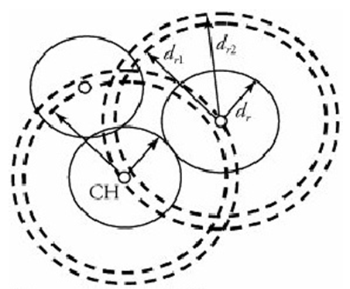

Slide 57
Major Problems with Wireless network

Slide 58
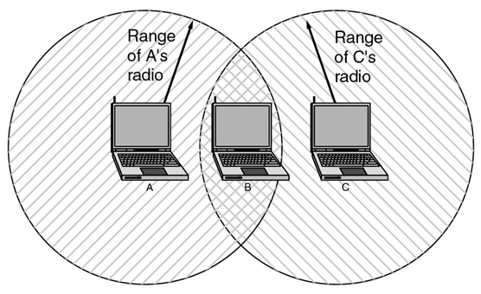
First Problem: A computer on Ethernet always listens to the ether before transmitting. Only if the ether is idle does the computer begin transmitting. With wireless LANs, that idea does not work so well. The range of a single radio may not cover the entire system
Suppose that computer A is transmitting to computer B (one way), but the radio range of A is too short to reach computer C. If C wants to transmit to B it can listen to the ether before starting, but the fact that it does not hear anything (since it is outside the coverage of A) does not mean that its transmission will succeed. The 802.11 standard had to solve this problem (CSMA/CA).
Notes:
IEEE 802.3-Ethernet -IEEE Protocol- wired computer networking technologies commonly used in local area networks (LAN), metropolitan area networks (MAN) and wide area networks (WAN)
Ethernet is a type of network cabling and signaling specifications developed by Xerox in the late 1970.
An Ethernet cable is one of the most popular forms of network cable used on wired networks.
The original 10BASE5 Ethernet uses coaxial cable as a shared medium, while the newer Ethernet variants use twisted pair and fiber optic links in conjunction with switches.

Slide 59
The problem we mentioned here is called Hidden Terminal Problem
A and B can hear each other. B and C can hear each other. But A and C cannot hear each other.
When A is sending data to B, C cannot sense this activity and hence C is allowed to send data to B at the same time. This will cause a collision at B.
collision
A
B
C
Consider the effect of RTS/CTS:
RTS/CTS (Request to Send / Clear to Send) is the optional mechanism used by the 802.11 wireless networking protocol to reduce frame collisions introduced by the hidden node problem.

Slide 60
Avoiding collisions
IEEE 802.11 at MAC sublayer uses CSMA/CA as the access method.
Standard 802.11 typically uses the carrier Sense Multiple Access with collision avoidance (CSMA/CA) method.
Carrier sense (CS) means: hardware capable of sensing whether transmission taking place in vicinity
With this method, each user listens for traffic coming from other users and transmits data if the channel is idle.

Slide 61
Carrier Sense Multiple Access/ Collision Avoidance (CSMA/CA)
The wireless LAN system cannot detect collisions because the power of the transmitting device is much stronger than the receiver’s power.
In this situation collision detection is not practical, it makes sense to try to device a system that can help prevent collisions. Thus the CA is CSMA/CA refers to ‘collision avoidance’.
In wired networks, if a collision has occurred then the energy of the received signal almost doubles, and the station can sense the possibility of collision. In the case of wireless networks, most of the energy is used for transmission, and the energy of the received signal increases by only 5-10% if a collision occurs. It can’t be used by the station to sense collision. Therefore CSMA/CA has been specially designed for wireless networks.

Slide 62
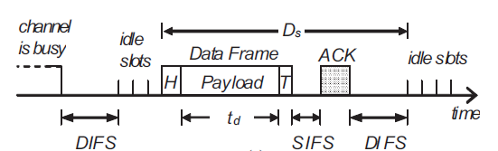
Distributed Binary Exponential Backoff Algorithm
To reduce the packet dropping probability or to enhance throughput of wireless LAN exponential binary backoff algorithm is widely used. The access method of MAC protocol of IEEE 802.11 based on exponential binary backoff algorithm can be explained with the following steps.
Step: 1
The transmitting node first senses the status of the channel. If the channel is found busy then the Tx node continues to monitor the channel.
Step:2
If the channel is found idle for a fixed duration known as DIFS (Distributed Inter-frame Space), the Tx chooses a random number according to the binary exponential back off algorithm. The random number is used as a back off timer.
Notes:
Carrier sense multiple access (CSMA) is a media access control (MAC) protocol in which a node verifies the absence of other traffic before transmitting on a shared transmission medium, such as an electrical bus, or a band of the electromagnetic spectrum.
Although CSMA/CA has been used in a variety of wired communication systems, it is particularly beneficial in a wireless LAN due to a common problem of multiple stations being able to see the Access Point, but not each other. This is due to differences in transmit power, and receive sensitivity, as well as distance, and location with respect to the AP.^{[5]} This will cause a station to not be able to 'hear' another station's broadcast. This is the so-called 'hidden node', or 'hidden station' problem. Devices utilizing 802.11 based standards can enjoy the benefits of collision avoidance (RTS / CTS handshake, also Point coordination function), although they do not do so by default. By default they use a Carrier sensing mechanism called 'exponential backoff', or (Distributed coordination function) that relies upon a station attempting to 'listen' for another station's broadcast before sending. CA, or PCF relies upon the AP (or the 'receiver' for Ad hoc networks) granting a station the exclusive right to transmit for a given period of time after requesting it (Request to Send / Clear to Send).^{[6]}

Slide 63
Step:3
Time immediately after the DIFS (Distributed Inter-frame Space) is slotted known as idle slots where the duration of a slot is considered as the sum of the time required to sense a station and to switch the Tx from sensing / listening mode to transmitting mode.
Step:4
Elapsing of each idle slot the back off timer is decreased by one. If the channel is found busy before the back off timer reaches to zero then repeat the steps 1 to 3. The transmission of data begins only if the back off timer reaches to zero.
Notes:
The essential data that is being carried within a packet or other transmission unit.
First time if the media is free it will only wait for DIFS time, but if it is more than one time or sense busy then it will wait additionally for backoff time.

Slide 64
Step:5
To determine whether a data frame transmission is successful, after its completion, a positive acknowledgement (ACK) is transmitted by the receiver. ACK is transmitted after a short interframe space (SIFS) period upon receiving the entire data frame successfully.
If ACK is not detected within an SIFS period after the completion of the data frame transmission, the transmission is assumed to be unsuccessful, and a retransmission is required. Sender usually uses binary exponential backoff.

Slide 65
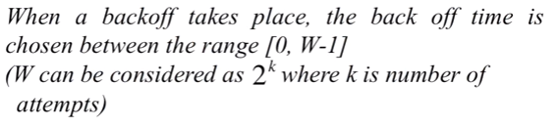

Slide 66
Avoiding collisions(more)
sender first transmits small request-to-send (RTS) packets to BS using CSMA
RTSs may still collide with each other (but they’re short)
BS broadcasts clear-to-send CTS in response to RTS
CTS heard by all nodes
sender transmits data frame
other stations defer transmissions
avoid data frame collisions completely
using small reservation packets!
Notes:
Unicast: one sends, one receives
Broadcasting: one sends, all receive
Multicasting: one sends, a group receives

Slide 67



Collision Avoidance: RTS-CTS exchange
A
B
AP
RTS(B)
RTS(A)
reservation collision
RTS(A)
CTS(A)
CTS(A)
DATA (A)
defer
time
ACK(A)
ACK(A)

Slide 68
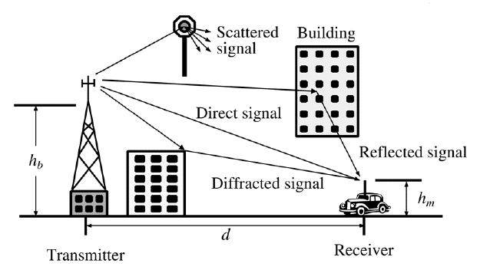
Second Problem:
In radio communication Multipath propagation (Multipath fading) due to presence of reflecting and refracting from water bodies and terrestrial objects such as mountains and buildings or even scatterers hence cause multiple versions of the signal arrive at the receiver through two or more paths.
Multipath propagation causes multipath interference, including constructive and destructive interference of the signal;
Destructive interference causes fading. This may cause a radio signal to become too weak in certain areas to be received adequately, so multipath propagation can be detrimental in radio communication systems.
Notes:
Multipath fading
A direct and Diffracted signal may or may not arrive at the received point in phase. Radio waves that are received in phase reinforce each other and produce a stronger signal at the receiving site, while those that are received out of phase produce a weak or fading signal. Small alterations in the transmission path may change the phase relationship of the two signals, causing periodic fading.
Signals are received in a terrestrial environment, i.e. where reflections are present and signals arrive at the receiver from the transmitter via a variety of paths. The overall signal received is the sum of all the signals appearing at the antenna. Sometimes these will be in phase with the main signal and will add to it, increasing its strength. At other times they will interfere with each other. This will result in the overall signal strength being reduced.

Slide 69
Small-scale fading, or simply fading, is used to describe the rapid fluctuations of the amplitudes, phases, or multipath delays of a radio signal over a short period of time or travel distance, so that large-scale path loss effects may be ignored. With small variation of distance and time cause wide variation of received signal experienced in a dense city.
Fading is caused by interference between two or more versions of the transmitted signal which arrive at the receiver at slightly different times. These waves, called multipath waves, combine at the receiver antenna to give a resultant signal which can vary widely in amplitude and phase, depending on the distribution of the intensity and relative propagation time of the waves and the bandwidth of the transmitted signal.
Notes:
Multipath fading
A direct and Diffracted signal may or may not arrive at the received point in phase. Radio waves that are received in phase reinforce each other and produce a stronger signal at the receiving site, while those that are received out of phase produce a weak or fading signal. Small alterations in the transmission path may change the phase relationship of the two signals, causing periodic fading.
Signals are received in a terrestrial environment, i.e. where reflections are present and signals arrive at the receiver from the transmitter via a variety of paths. The overall signal received is the sum of all the signals appearing at the antenna. Sometimes these will be in phase with the main signal and will add to it, increasing its strength. At other times they will interfere with each other. This will result in the overall signal strength being reduced.

Slide 70
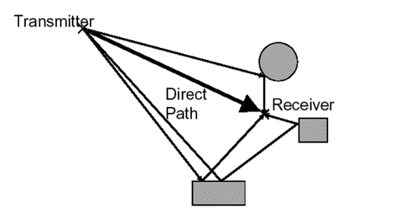
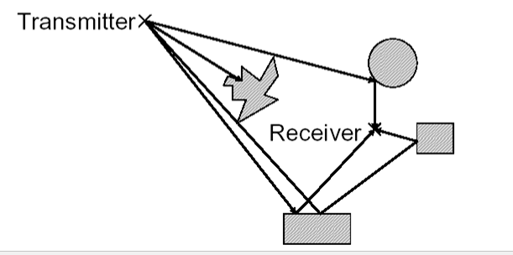
When the magnitudes of the signals are arrived by the various paths have a distribution known as the Rayleigh distribution and the fading is known as Rayleigh fading, where all the components are non-LOS:
i.e. there is no line-of–sight (LOS) component.
When one of the multipath components (a line of sight component) dominates, a Rician distribution provides a more accurate model, and this is known as Rician fading. i.e. there is one LOS component
Rayleigh fading
Rician fading
Notes:
Multipath fading
A direct and Diffracted signal may or may not arrive at the received point in phase. Radio waves that are received in phase reinforce each other and produce a stronger signal at the receiving site, while those that are received out of phase produce a weak or fading signal. Small alterations in the transmission path may change the phase relationship of the two signals, causing periodic fading.
Signals are received in a terrestrial environment, i.e. where reflections are present and signals arrive at the receiver from the transmitter via a variety of paths. The overall signal received is the sum of all the signals appearing at the antenna. Sometimes these will be in phase with the main signal and will add to it, increasing its strength. At other times they will interfere with each other. This will result in the overall signal strength being reduced.

Slide 71
FHSS inherently solves the multipath problem by simply hopping to other frequencies.
Other systems use anti-multipath algorithms to avoid this interference.
Notes:
Multipath fading
A direct and Diffracted signal may or may not arrive at the received point in phase. Radio waves that are received in phase reinforce each other and produce a stronger signal at the receiving site, while those that are received out of phase produce a weak or fading signal. Small alterations in the transmission path may change the phase relationship of the two signals, causing periodic fading.
Signals are received in a terrestrial environment, i.e. where reflections are present and signals arrive at the receiver from the transmitter via a variety of paths. The overall signal received is the sum of all the signals appearing at the antenna. Sometimes these will be in phase with the main signal and will add to it, increasing its strength. At other times they will interfere with each other. This will result in the overall signal strength being reduced.

Slide 72
Handoff Region
Third Problem: Handoff is necessary like mobile communications.
A well-implemented handoff is important for delivering uninterrupted service to a caller or data session user
Signal strength due to BS_{i}
Signal strength due to BS_{j}
P_{i}(x)
P_{j}(x)
E
P_{min}
BS_{i}
MS
BS_{j}
X₁
X₃
X₅
X_{th}
X₄
X₂
By looking at the variation of signal strength from either base station it is possible to decide on the optimum area where handoff can take place.
Notes:
A handoff refers to the process of transferring an active call or data session from one cell in a cellular network to another or from one channel in a cell to another.
In Europe and other countries, a handoff is known as a handover.

Slide 73
Fourth Problem: Some times software is not aware of mobility. For example many word processors have a list of printers that users can choose to print a file. When the computer on which the word processor runs is taken into a new environment, the built-in list of printer becomes invalid.

Slide 74
Carrier Sense Multiple Access/ Collision Detection (CSMA/CD)
Carrier-sense multiple access with collision detection (CSMA/CD) is a media access control (MAC) method used most notably in early Ethernet technology for local area networking.
It uses carrier-sensing to defer transmissions until no other stations are transmitting. This is used in combination with collision detection in which a transmitting station detects collisions by sensing transmissions from other stations while it is transmitting a frame.
When this collision condition is detected, the station stops transmitting that frame, transmits a jam signal, and then waits for a random time interval before trying to resend the frame.
CSMA/CD is a modification of pure carrier-sense multiple access (CSMA). CSMA/CD is used to improve CSMA performance by terminating transmission as soon as a collision is detected, thus shortening the time required before a retry can be attempted.

Slide 75
Carrier Sense Multiple Access/ Collision Detection (CSMA/CD)
A collision detection mechanism compares the amount of energy on the media after a packet is transmitted. If the value is greater than the energy used by the transmitting device, then a collision has occurred. If there is no difference the two measured values, then a collision has not occurred.

Slide 76
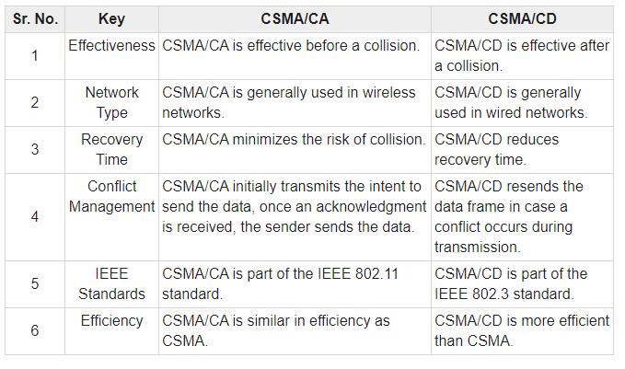
Notes:
intent

Slide 77
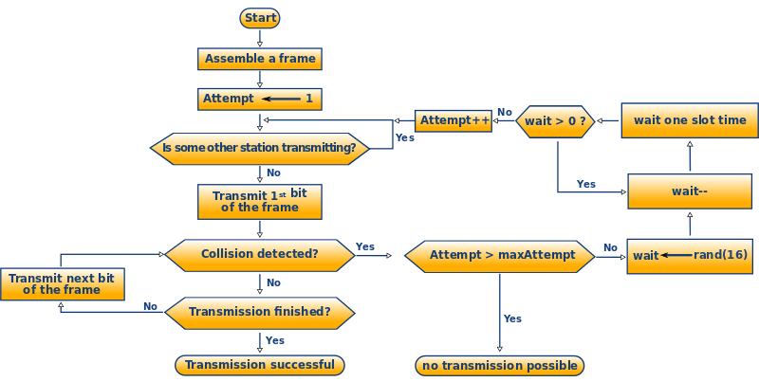
Flow Chart CSMA/CD-Algorithm

Slide 78
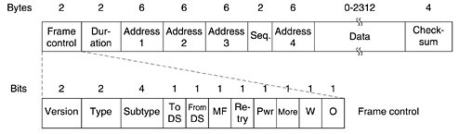
The frame format of IEEE 802.11
The frame control (FC) field provides information on the type of frame has 11 subfields.
The first of these is the Protocol version, two bits representing the protocol version. Currently used protocol version is zero. Other values are reserved for future use.
Then come the Type of 2 bits (data, control, or management); where ‘Type of information: management (00), control (01), or data (10)’.

Slide 79
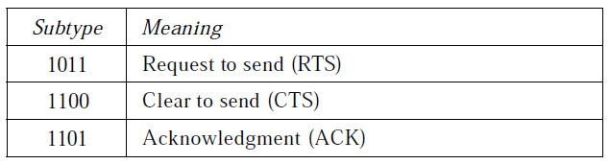
A node wishing to send data initiates the process by sending a Request to Send frame (RTS). The destination node replies with a Clear To Send frame (CTS). Subtype fields indicates like the following category.
Values of subfields in control frames

Slide 80
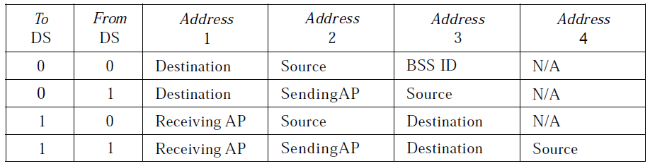
The IEEE 802.11 addressing mechanism specifies four cases, defined by the value of the two flags in the FC field, To DS and From DS. Each flag can be either 0 or 1, resulting in four different situations. The interpretation of the four addresses (address 1 to address 4) in the MAC frame depends on the value of these flags, as shown in Table below.

Slide 81
The MF bit means that more fragments will follow. The Retry bit marks a retransmission of a frame sent earlier. The Power management bit is used by the base station to put the receiver into sleep state or take it out of sleep state. The More bit indicates that the sender has additional frames for the receiver.
The W bit specifies that the frame body has been encrypted using the WEP (Wired Equivalent Privacy) algorithm. Finally, the O bit tells the receiver that a sequence of frames with this bit on must be processed strictly in order.

Slide 82
Duration field refers to the time allotted for the successful transmission of the frame. How long the frame and its ack will occupy the channel.
The address field denotes the 6-byte (MAC address of 48 bits) source and destination address fields. The source and destination addresses are obviously needed and the other two addresses are used for source and destination BSs for intercell traffic. Since frame may enter or leave a cell via a BS.
The sequence control (SC) field consists of 4 bits reserved for fragmentation and reassembly and 12 bits for a sequence number of frames between a particular Tx and Rx.
The frame body/Data contains a MAC service data unit or control information.
The CRC field is used for error detection.

Slide 83
Thank You

